Slide 1

INSTITUTE- UIE
DEPARTMENT- ECE
Bachelor of Engineering (Electronics & Communication Engineering)
20ECT487 :: Quantum Physics
Prepared By: Dr. Kuleen Kumar
DISCOVER . LEARN . EMPOWER

Slide 2
Fundamentals of Quantum Physics
Course Outcome
CO1 Understanding the fundamentals of the Quantum Physics.
CO2 Understanding the basics theory of optical quantum.
CO3 Understanding the theory of Quantum Computing fundamentals.
CO4 Apply the knowledge on design using Quantum Circuits
CO5 Analyze and apply the knowledge of Quantum Computing

Slide 3
Goal of Chapter
The basic phenomena of the quantum physics and experimental background, particles
Atomic models
Black-body radiation
line spectra
The photon
Photoelectric effect,
Compton-dispersion. Bohr's atomic model.

Slide 4
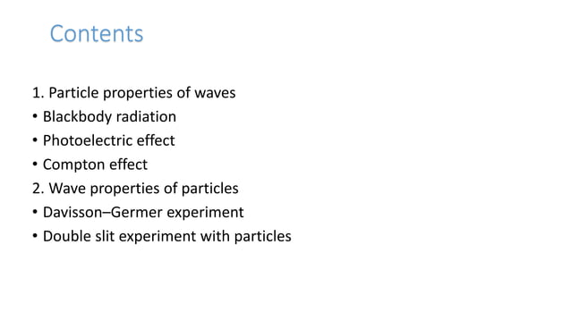

Slide 5
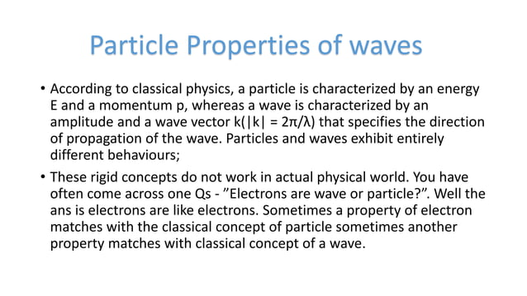

Slide 6
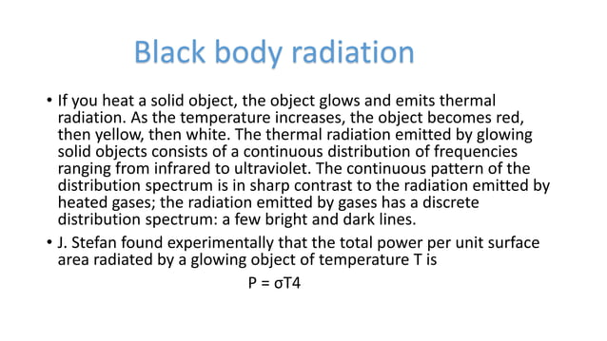

Slide 7
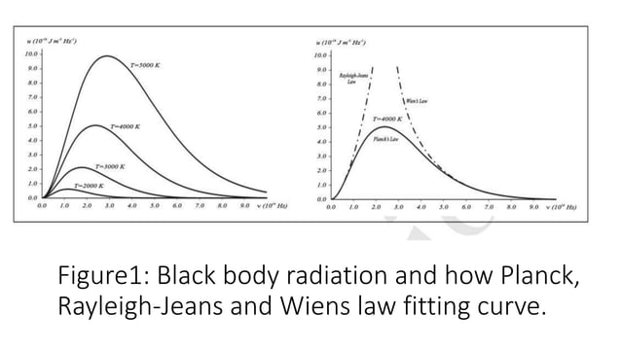

Slide 8
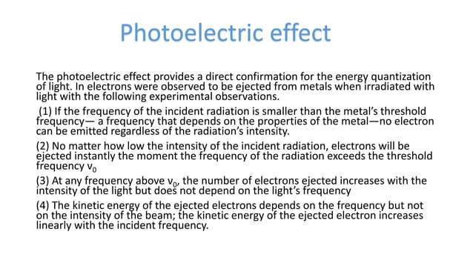

Slide 9
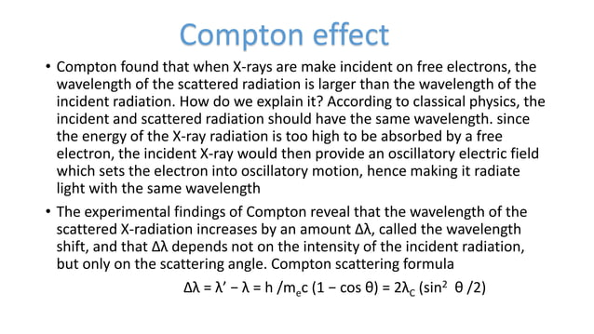

Slide 10
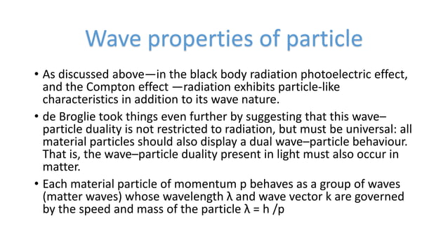

Slide 11
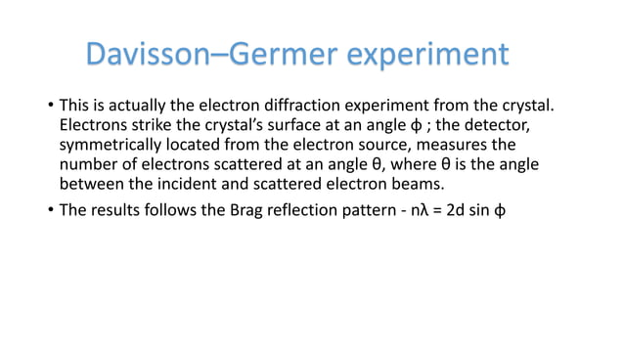

Slide 12
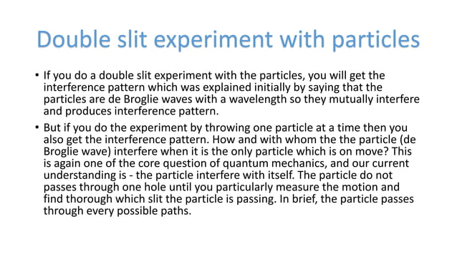

Slide 13
SUMMARY
Basic Idea and Consideration
Reviews of Quantum effects
Basic Phenomenon of quantum Physics
Bohr’s Atomic Model

Slide 14
Assessment Pattern
ELEMENT I : QUIZ – 4 MARKS
ELEMENT II : SURPRISE TEST – 3 MARKS
ELEMENT III : ASSIGNMENT – 4 MARKS
ELEMENT IV : TUTORIAL/ ASSIGNMENT – 3 MARKS
TWO MSTs – 36 MARKS (each)
END TERM EXAM – 60 MARKS

Slide 15
REFERENCES
[1] Michael A. Nielsen & Isaac L. Chuang, Quantum Computation and Quantum Information, CAMBRIDGE UNIVERSITY PRESS, 2002, 10th Edition, 2010.
[2] Benenti G., Casati G. and Strini G., Principles of Quantum Computation and Information, World Scientific Publishing Co. Pvt. Ltd., 1stEdition Reprinted, 2005.

Slide 16
THANK YOU
For queries
Email:

